Slide 1

Classifying Resumes with Machine Learning
Machine Learning Project
Done by:
Basava Sanketh BN
This Photo by Unknown Author is licensed under CC BY

Slide 2

Agenda
Introduction
Problem Statement
Data Collection
Exploratory Data Analysis
Data visualisation
Model building
Model Evaluation
Conclusion

Slide 3

Introduction
The challenge of finding the right candidate for a role can be daunting.
Machine learning provides an opportunity to automate this process and make it more efficient.
This presentation will explore a machine learning python project that designs a classifier to determine if a candidate resume is applicable for a given role.
This classifier will use machine learning algorithms to analyze resumes and make predictions.
The goal is to accurately predict whether a candidate is suitable for a given role or not.

Slide 4

Aim and Problem Statement
Aim: The aim of this project is to develop a machine learning classifier that can accurately screen resumes and determine whether a candidate is suitable for a given role. The project will involve exploring and analyzing resume data, building and training machine learning models, and creating a dashboard to visualize the results.
Problem Statement: The project aims to develop a machine learning classifier to screen resumes and determine whether a candidate is suitable for a given role. The classifier will be trained on a dataset of resumes and job descriptions, and the project will involve exploring and analyzing the data, building and training machine learning models, and creating a dashboard to visualize the results.

Slide 5

Data Collection
We have got dataset from the Kaggle
https://www.kaggle.com/datasets/mathchi/diabetes-data-set/download?datasetVersionNumber=1
This dataset consists of 2 columns and 962 rows

Slide 6

EDA
Checking for missing and duplicates values
Done Feature engineering
Done Feature scaling (Standard Scaler)

Slide 7
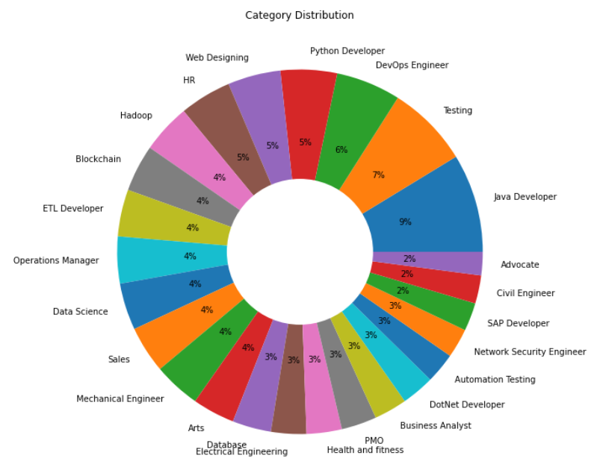
Data visualisation

Slide 8
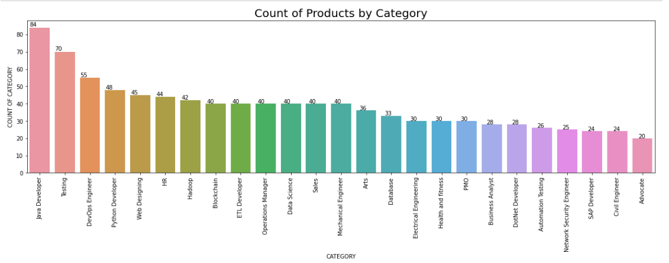
Data visualisation

Slide 9

Model building
Machine learning algorithms are powerful tools for analyzing data.
In this project, machine learning algorithms will be used to analyze the data and identify patterns and trends that could explain Classify Resumes .
Kneighbors Classifier will be used to build models that can predict Classify Resumes .
The model will be evaluated using various metrics such as accuracy, precision, and recall.

Slide 10
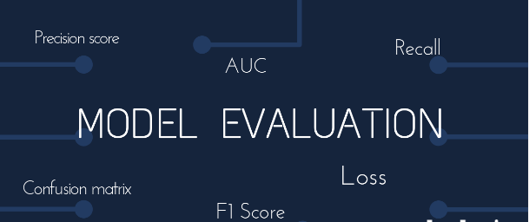
Model Evaluation
Evaluating the models performance using metrics such as accuracy, precision and recall.
Interpreting the results and providing insights on the reasons for Classify Resumes .

Slide 11
Conclusion
In conclusion, this project aims to develop a machine learning classifier that can accurately screen resumes and determine whether a candidate is suitable for a given role.
The project will involve exploring and analyzing resume data, building and training machine learning models, and creating a dashboard to visualize the results.
The outcome of this project will be a useful tool for businesses that receive a high volume of resumes and need to quickly identify suitable candidates.

Slide 12


